Slide 1
Directive 2012/29/EU Victim Support System in the Czech Republic
Mr. Adam Štix
3rd March 2022
CJPE Webinar
Victims’ rights in prison and probation - What is our role?

Slide 2
Victim Support - Development
Czech criminal justice – retributive, focus on the offender, relatively no interest in victims;
Victim as a witness (source of evidence);
Victim support limited – NGOs, e.g. White Circle of Safety;
Improving situation - amendment of criminal legislation (e.g. Victim as harmed party, damage compensation);
Directive 2012/29/EU
Standards of victim support
Strengthen position of the victim
Ensure sensitive treatment

Slide 3
Act No. 45/2013 Coll., on Victims of Crime
Effective August 1st, 2013 (amendments 2015, 2017, 2021, 2022)
Minimum standard of victims’ rights
Definition of a Victim - a person who has been, or should have been injured, or has suffered property or non-property damage or at whose expense the perpetrator has enriched him/herself as a result of a criminal offence
Secondary victims - direct relatives to the victim who has died as a result of a criminal offence - status of victim
Especially vulnerable victims – special rights
Prohibition of discrimination
Polite and sensitive treatment
Individual approach to victims (gender, age, etc.)
Understandable information by institutions provided to victims
Cooperation among institutions

Slide 4
Act No. 45/2013 Coll., on Victims of Crime
Subject matter
Victims' rights (not rights of the harmed party - Code of Criminal Procedure)
Financial aid for victims (from the state)
Relationship between the state and organizations providing assistence to victims -> specified in the Register of Providers of Victim Support

Slide 5
Register of Victim Support Providers
Accreditation by the Ministry of Justice:
Providers of social services (psychological / social counseling)
Accredited providers of legal information or restorative programmes
Lawyers (legal assistance)
Centres of the Probation and Mediation Service
In Prachatice region: 1/2/17(1)/1
https://otc.justice.cz/verejne/seznam.jsf

Slide 6
Victim Support - Current Situation
Improving situation (due to EU Directive/Act on Victims)
Mostly NGOs (Act No. 108/2006 Coll., on Social Services)
Special focus

Slide 7
Victim Support - Current Situation
NONSTOP HELPLINE - 116 006 (White Circle of Safety)
Free of charge
Availability of services (capacity, regional level)
Lack of awareness about victim support
Level of cooperation with law enforcement authorities
Role of lawyers – limited free legal assistance
Problems with awarding compensation (failure to meet deadlines)
Right to information x too much information?

Slide 8
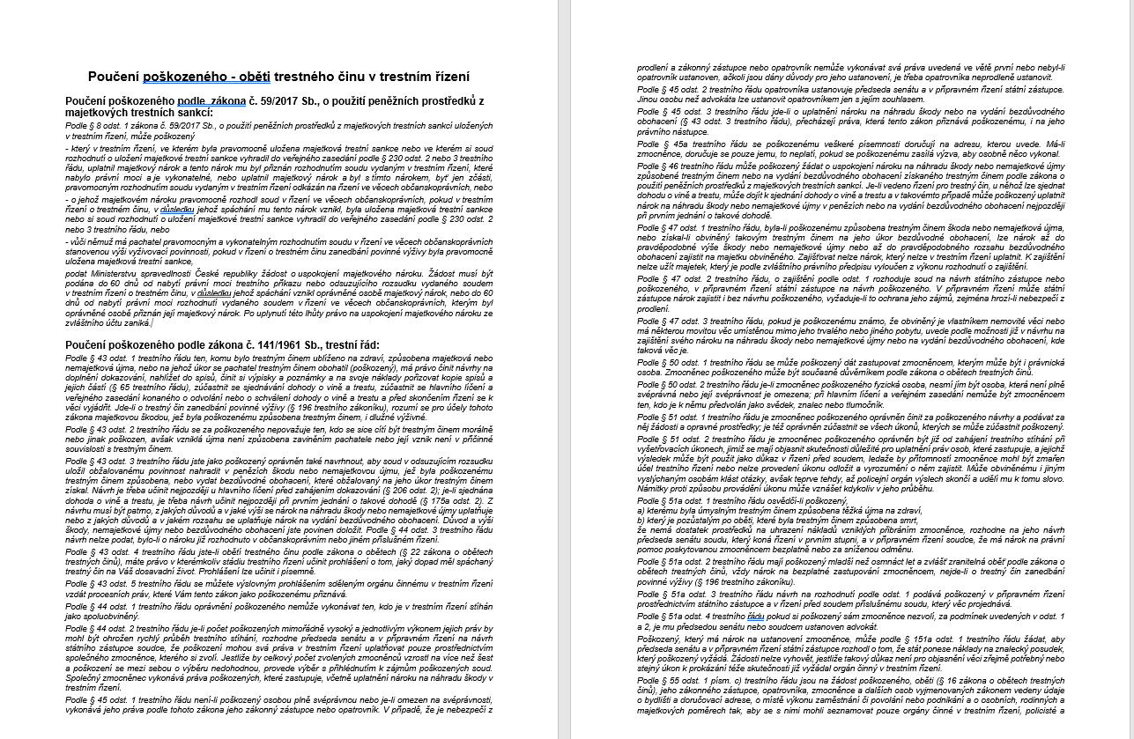

Slide 9
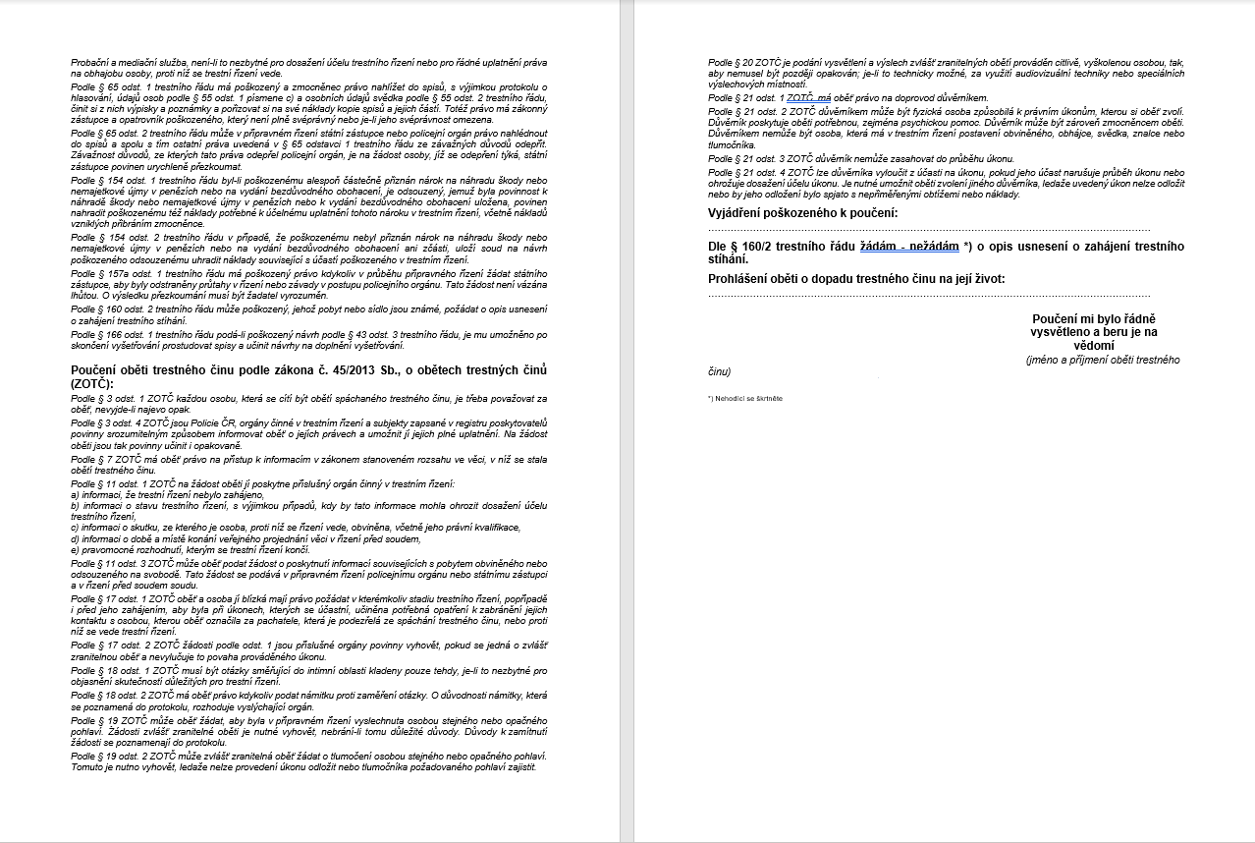

Slide 10
Role of the Probation and Mediation Service in Victim Support
Probation and Mediation Service
governmental component unit subordinate to the Ministry of Justice;
74 service centres in the Czech Republic in 8 judicial regions (27 of them with counselling centres);
Probation tasks:
the enforcement of community sanctions (community service, house arrest, entry ban, supervision of conditionally sentenced offenders, supervision of conditionally released offenders and duties related to it);
Victim tasks:
assistance to the victims of crime, victim-offender mediation and other restorative practices;
In 2021, the service centres started cooperating with 4,281 victims.

Slide 11
Safe Environment
Crime victims can visit any Probation and Mediation Service centre;
All probation and mediation workers have received education and training in crime victim´s assistance;
If appropriate, probation and mediation workers provide information on available local/national victim support networks (NGOs, psychologists, attorneys, social services, Register of Providers of Victim Support, etc.);
If necessary, probation and mediation workers can visit crime victims in their homes (e.g., when the crime victim is injured, unable to walk, etc.).

Slide 12
Crime Reporting
Probation and mediation workers can assist the victims who want to report the crimes by:
Listening to their needs and feelings;
Explaining criminal proceeding steps;
Providing them with basic legal information;
Refering them to the appropriate police station or prosecutor‘s office, provide contact information;
If necessary, accompanying them to the police station.

Slide 13
Victim Support
Probation and mediation workers can assist the crime victims in:
Requesting the compensation for victims of crime (from the state);
Preparing the Victim Impact Statement;
Claiming compensation for damages in criminal proceedings.

Slide 14
Victim Support
Probation and mediation workers can assist the crime victims in all stages of criminal proceedings, trying to use restorative justice approaches, if possible;
Pre-trial - e.g. mediation, compensation of damages, victim impact statement, financial compensation for crime victims.
Post-trial - e.g. mediation, financial compensation for crime victims.

Slide 15
Victims´ Groups
Probation and mediation workers can assist the crime victims of all types and ages. If the victim is younger than 18 yrs of age, we also work with their parents and cooperate with relevant children services (office for social and legal protection of children).
Probation and Mediation Service also works with the offenders of all ages – adults, juveniles, children.

Slide 16
Case Study
Victim of domestic violence – woman (23 yo);
Probation and Mediation Service authorized by the prosecutor;
Activities
Information about the Probation and Mediation Service, legal information (criminal proceedings, rights);
Listening and identifying victim‘s needs;
Specific outputs of the cooperation: application for legal representation free of charge, request for interim injunction (restraining order), arrangement of contact with crisis centre.

Slide 17
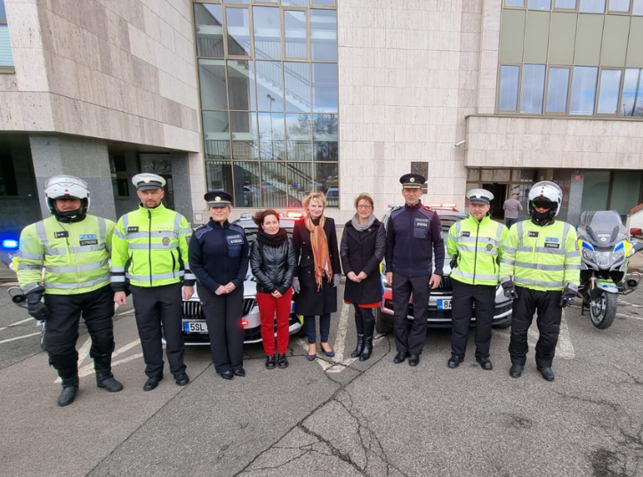

Slide 18
Thank you for your attention.
Contact: astix@pms.justice.cz
+420 778 492 746
Probation and Mediation Service
Regional Center Prachatice

